Slide 1
Compiler Design
Submitted To:
Humayara Binte Rashid ( Lecturer NDUB )
Submitted By:
1) Shazidul Alam (0692220005101009)
2) Anisur Rahman Naeem (0692220005101015)
3) Faisal Morshed Akash (0692220005101007)
Batch: CSE- 19
01

Slide 2
CONTENTS OF THIS TEMPLATE
Here’s what you’ll find in this template:
1) About Lexical analysis
2) Necessary Steps of Flex
3) Uses of the Token
4) Different Parts of Compiler
5) Flex Code Demonstration
6) Main Code
7) The Output
8) Conclusion
02

Slide 3
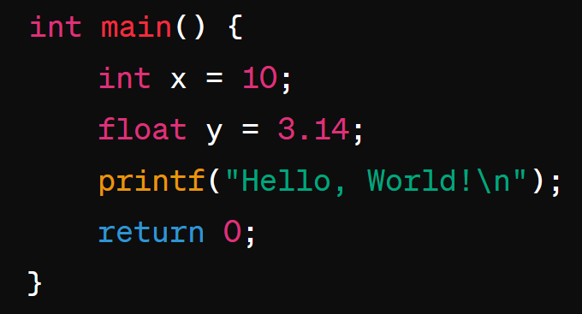
Lexical analysis
Lexical analysis is the initial phase of a compiler, where the source code is scanned and broken down into tokens. It identifies the smallest meaningful units, such as keywords, identifiers, and literals.
Keywords: int, float, return
Identifiers: main, x, y
Literals: 10, 3.14
Punctuation: (, ), =, ;, ,
Strings: "Hello, World!\n"
03

Slide 4

Necessary Tools of Flex
1) Flex Installation: Download flex from any browser then install it.
2) Path Selection: Copy the bin file locaion from flex and paste it on system environment variables.
3) Text File: Create a text file. Rename it and add .l as extension. i.e: demo.l .
4) File: Create a completely separate file and put the .l file in it.
5) Command Promt: Firstly run the .l file as flex demo.l
Secondly run the lex file gcc lex.yy.c
Thirdly run the .exe file as a.exe
04

Slide 5
Uses of the Token
05
Token | Description | Example
if | Conditionally execute a block of code | if (x > 5){ printf("x is greater than 5\n");
else | The "else" keyword specifies a block of code that executes when the "if" condition is false. | if (x > 5) { printf("x is greater than 5\n"); } else { printf("x is 5 or less\n");
while | The "while" keyword in programming languages is used to create a loop. | while (count < 5) { printf("Count: %d\n", count);
do | The "do" keyword is used in programming languages to create a loop that executes a block of code at least once. | do { printf("Count: %d\n", count); count++;
switch | The "switch" keyword is used in programming languages to create a selection statement. | switch (day) { case 1: printf("Monday\n"); break; case 2: printf("Tuesday\n"); break;
case | The "case" keyword is used within a switch statement in programming languages to define different branches of code | switch (num) { case 1: printf("one\n"); break; case 2: printf("two\n"); break;
for | The "for" keyword is used in programming languages to create a loop that repeats a block of code. | for (int i = 0; i < 5; i++) { printf("Value of i: %d\n", i);

Slide 6
Uses of the Token Cont.
Token | Description | Example
char | The char keyword is used to declare a variable of character. | char letter = 'A';
const | The const keyword in programming languages such as C is used to declare a variable whose value cannot be changed once it is initialized. | const int num = 42;
continue | The continue keyword is used to skip the remaining code in the current iteration of a loop and proceed to the next iteration. | for (int i = 0; i < 5; i++) { if (i == 2) { continue;
default | The default keyword is used in a switch statement to specify the code block that should execute if none of the specified case options match the switch expression. | case 2: printf("Value is 2\n"); break; default: printf ("Value is not 1 or 2\n"); break;
double | The double keyword used to declare a variable that can store double-precision floating-point numbers. | double pi = 3.141592653589793;
enum | The enum keyword is used to define a new data type that consists of a set of named integer constants. | enum Color{RED, GREEN, BLUE }; int main(){ enum Color favoriteColor = GREEN;
06

Slide 7
Uses of the Token Cont.
Token | Description | Example
extern | The extern keyword is used to declare a variable or function that is defined in another source file. | int externVar = 10; void externFunction() { printf("This is an externl function.\n");
float | The float keyword is used to declare a variable that can store single-precision floating-point numbers. | float pi = 3.14f;
goto | The goto keyword is used to transfer control unconditionally to a specified label in the code. | if (num > 3) { goto label; label: printf("This is the label. \n");
int | The int keyword is used to declare a variable that can store integer values. | int number = 10;
long | The long keyword is used to declare a variable that can store long integer values. | long largeNumber = 1000000000L;
register | The register keyword is a storage class specifier that suggests to the compiler that a variable should be stored for faster access. | register int counter;
return | The return keyword is used such as C to exit a function and return control to the caller. | return 0;
07

Slide 8
Uses of the Token Cont.
Token | Description | Example
short | The short keyword is a data type specifier used to declare a variable that can store integer values but with a smaller range. | short smallNumber = 32767;
signed | The signed keyword is a data type specifier used to declare a variable that can store both positive and negative integer values. | signed int number = -10; printf("The signed integer value is: %d\n", number);
sizeof | The sizeof operator is used to determine the size of a data type or a variable in bytes. | int intSize = sizeof(int);
static | The static keyword in C is used to control the visibility and lifetime of variables and functions. | static int count = 0;
struct | struct (short for "structure") is a composite data type that allows us to group different data types together into a single unit. | struct Person { char name[50]; int age;
typedef | The typedef keyword is used to create a new name or alias for an existing data type. | typedef unsigned long ulong; int main() ulong largeNumber = 1000000UL; {
08

Slide 9
Uses of the Token Cont.
Token | Description | Example
break | The break keyword in programming languages is used to exit a loop. (for, while, or do-while) | case 1: printf("One\n"); break;
union | The union keyword is used to define a user-defined data type that allows multiple members to share the same memory location. | union Data { int i; float f; char str[20];
unsigned | The unsigned keyword is a data type specifier that declares a variable or integer type as only capable of holding non-negative values. | int main() { unsigned int positiveNumber = 4294967295;
void | The void keyword is a special data type that represents the absence of any type. | void printMessage() { printf("This function returns nothing.\n");
volatile | The volatile keyword is used as a qualifier for variables to indicate that their values may change unexpectedly and frequently, outside of the normal program flow. | volatile int interruptFlag = 0;
09

Slide 10
Different Parts Of Compiler
a) Lexical Analyzer: A lexical analyzer reads source code character by character, identifies tokens like keywords and identifiers, and produces a stream of tokens as output. b) Syntax Analyzer: A syntax analyzer, or parser, checks the structure of source code using grammar rules, ensuring correctness and detecting syntax errors. c) Semantic Analyzer: A semantic analyzer checks the meaning of source code beyond its structure, verifying type compatibility, variable declarations, and function calls. d) Intermediate Code Generator: An intermediate code generator creates an intermediary representation of source code, which is independent of the target machine architecture, facilitating optimization and portability. e) Machine-Independent Code Optimizer: A machine-independent code optimizer improves the efficiency and performance of intermediary code, regardless of the target machine, through various optimization techniques. f) Code Generator: A code generator translates optimized intermediary code into target-specific instructions, such as machine code or assembly language, for execution on the target hardware. g) Machine-Dependent Code Optimizer: A machine-dependent code optimizer further enhances the efficiency and performance of generated code by tailoring optimizations to the specific characteristics of the target hardware architecture.
10

Slide 11
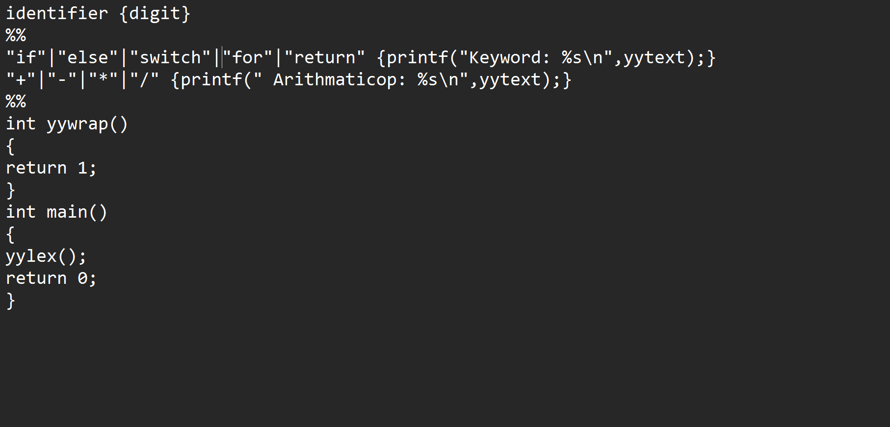
Flex Code Demonstration
Definition
Rules
Subroutines
11

Slide 12
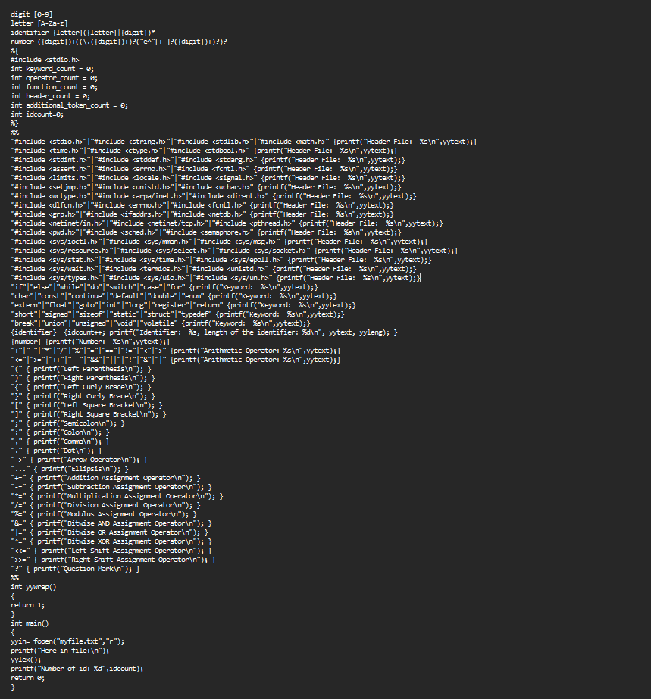
Main Code
12

Slide 13
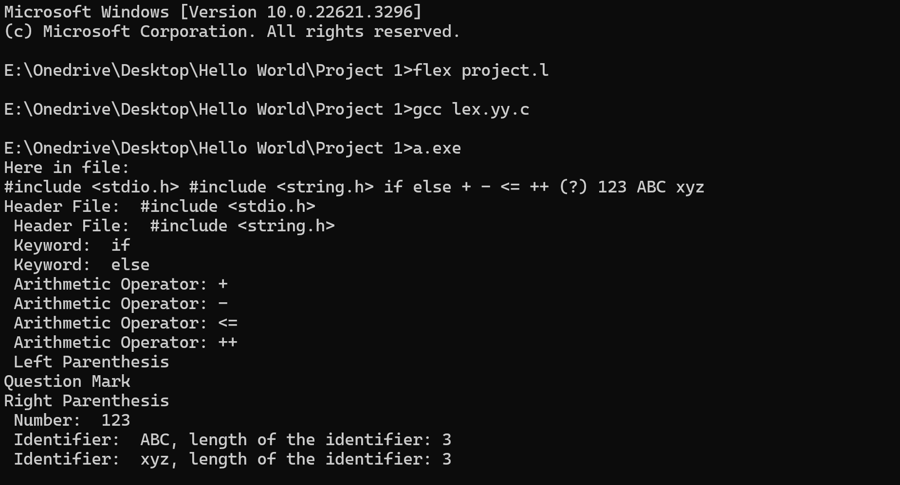
The Output
13

Slide 14
Conclusion
Lexical analysis is an essential stage in the compilation process that transforms source code into a sequence of tokens, such as keywords, identifiers, and literals. This forms the basis for further parsing and code generation.
Flex, a tool for generating lexical analyzers, simplifies the process by allowing developers to define patterns with regular expressions and automatically generating C code for lexical analysis. The combination of lexical analysis and flex facilitates the creation of efficient language processors, interpreters, and compilers.
14

Slide 15
THANKS EVERYONE
15

